Slide 1

MSDS 670: Week 6
Name: Mary Crawley
Class: MSDS 670-Data Visualization
School: Regis University
Professor: John Koening
Date: October 02, 2022

Slide 2
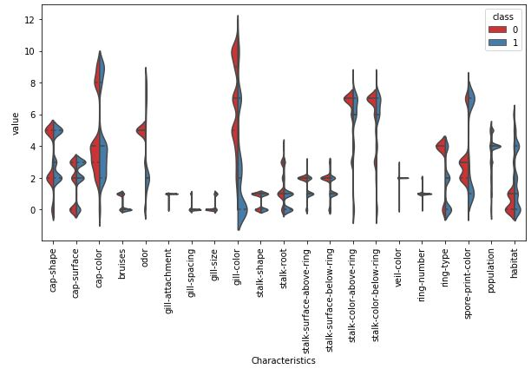
Mushrooms: Violin Plot
Gill-color has the larger data with a value of 12 for class 0 and value 7 for class 1.
Smallest data is both gill-spacing and gill-size with a little over over 0.
Stalk-color-above-ring and stalk-color-below-ring shows the same the same peak in data around value 7. Cap-color has the biggest peak at around value 4.

Slide 3
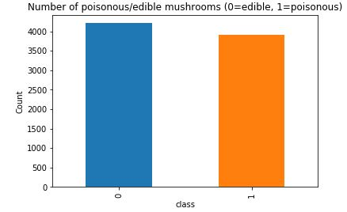
Mushrooms: Bar Chart
Bar Chart showcases the balance in our data—having a great balance between poisonous (1-orange) and edible(0-blue) mushrooms.
The data has more edible mushrooms, having over 4,000 edible mushrooms, than poisonous mushrooms with approximately 3,600 poisonous mushrooms in our dataset.
Deep learning would be a great tool to train our data to show which mushroom is edible and which is not.

Slide 4
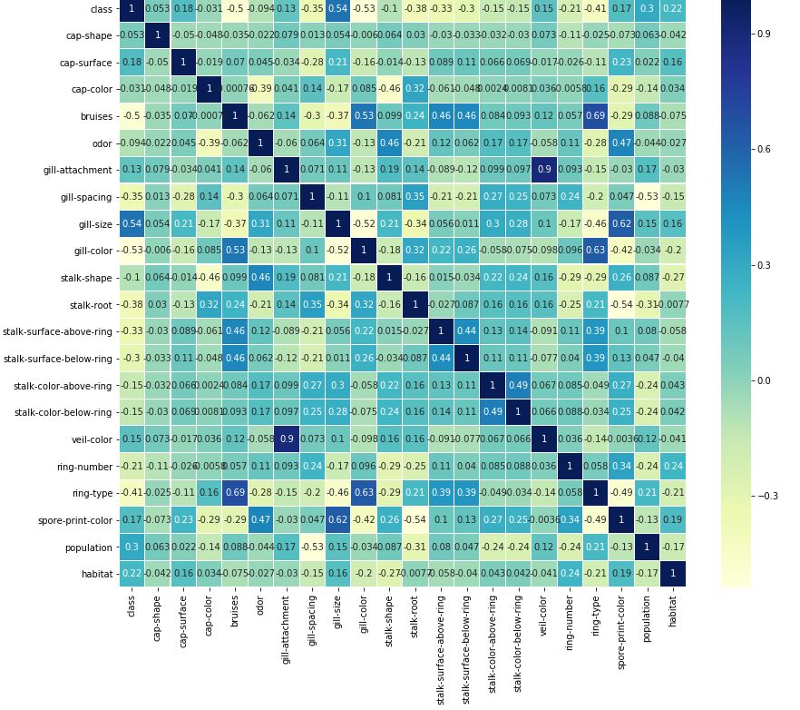
Mushrooms: Heat Map
The least correlated variable is ‘gill-color’, with a result of -0.53
Gill-size is the most correlated variable, resulting in 0.54.
For deeper analysis, we would want to focus on gill-color to see why it is the least correlated variable in our dataset.

Slide 5
Conclusion
We learned that our dataset is balanced with edible mushrooms having more data with a count of 4,000 and poisonous mushrooms having roughly 3,600 count. Also, focus for future analysis is gill-color to understand why it has the least correlated variable with a median of 2, 5, and 9 in our violin plot.

